Slide 1


FACULTY OF COMPUTING AND INFORMATICS
UNIVERSITI MALAYSIA SABAH
SEMESTER 2 2015/2016
INDUSTRIAL TRANNING AT MOTION ANALYSIS LAB UNIVERSITY BRUNEI DARUSSALAM
NAME | NURUL FATIHAH BINTI MOHD RASID TUAN MOHD SAIFUDDIN BIN TUAN MOKHTAR
PROGRAME CODE & NAME | HC05 NETWORK ENGINEERING HC00 SOFTWARE ENGINEERING
ORGANIZATION NAME | FACULTY OF SCIENCE , UNIVERSITI BRUNEI DARUSSALAM
ACADEMIC SUPERVISOR NAME | ASSOCIATE PROFESSOR DR JASON TEO
INDUSTRIAL SUPERVISOR NAME | ASSOCIATE PROFESSOR DR S. M. N. AROSHA SENANAYAKE
TUTOR | MR UMAR YAHYA

Slide 2
Category of our internship task
1) Database design
2) Website development
3) Graphics design
4) Report writing and project documentation

Slide 3
Specific tasks to be completed
1) An Inventory Management System for Motion Analysis Lab (1.5 month)
2) Research Website template (2.5 month)
3) Design of a trifold brochure with research prospects of Motion Analysis lab (1 month)
4) Report Writing (1 month)

Slide 4
Skill to be achieved through the task
Practical Skills
Setup and configuration of IDE environment (Apache/MySQL/Dreamweaver).
Working with MySQL database
Working with a combination of PHP, SQL, JSP, CSS, and HTML scripting languages.
Setting up adhoc networks to allow sharing of software solutions within MAL’s computer whenever required.

Slide 5
Communication skill
Learning how to translate routine tasks into software solution
Learning how to remain objective when taking instructions from my team/tutor/supervisor.
Increase productivity in developing a system.
Team work
Learning effective collaboration for timely completion of group tasks
Increase vigilance at work place and learning to take full responsibility of work place actions

Slide 6
Completed tasks
1) An Inventory Management System for Motion Analysis Lab
Using a database platform based to design a database management system to manage MAL inventory.
System allow such data operation as; retrieving specific inventory information, editing existing information, adding new information, placement of requisition of equipment, consumable and quotation generation.

Slide 7
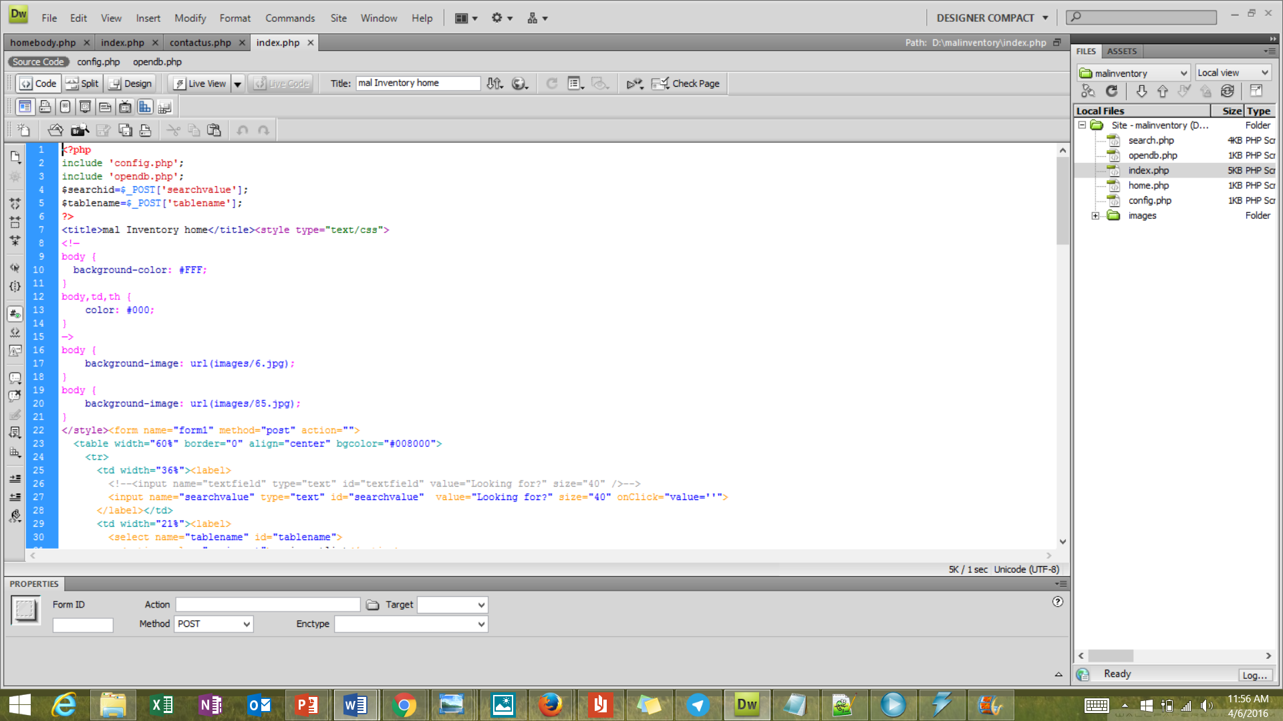
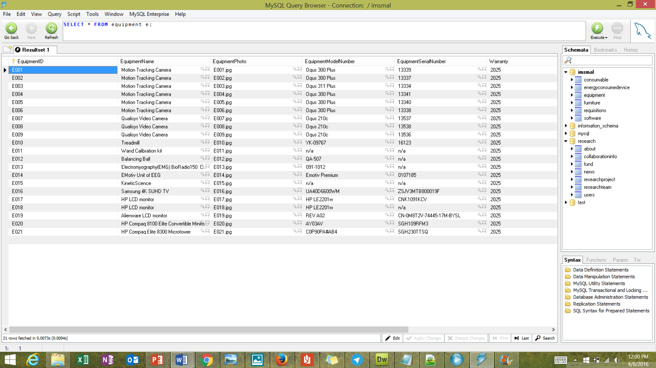
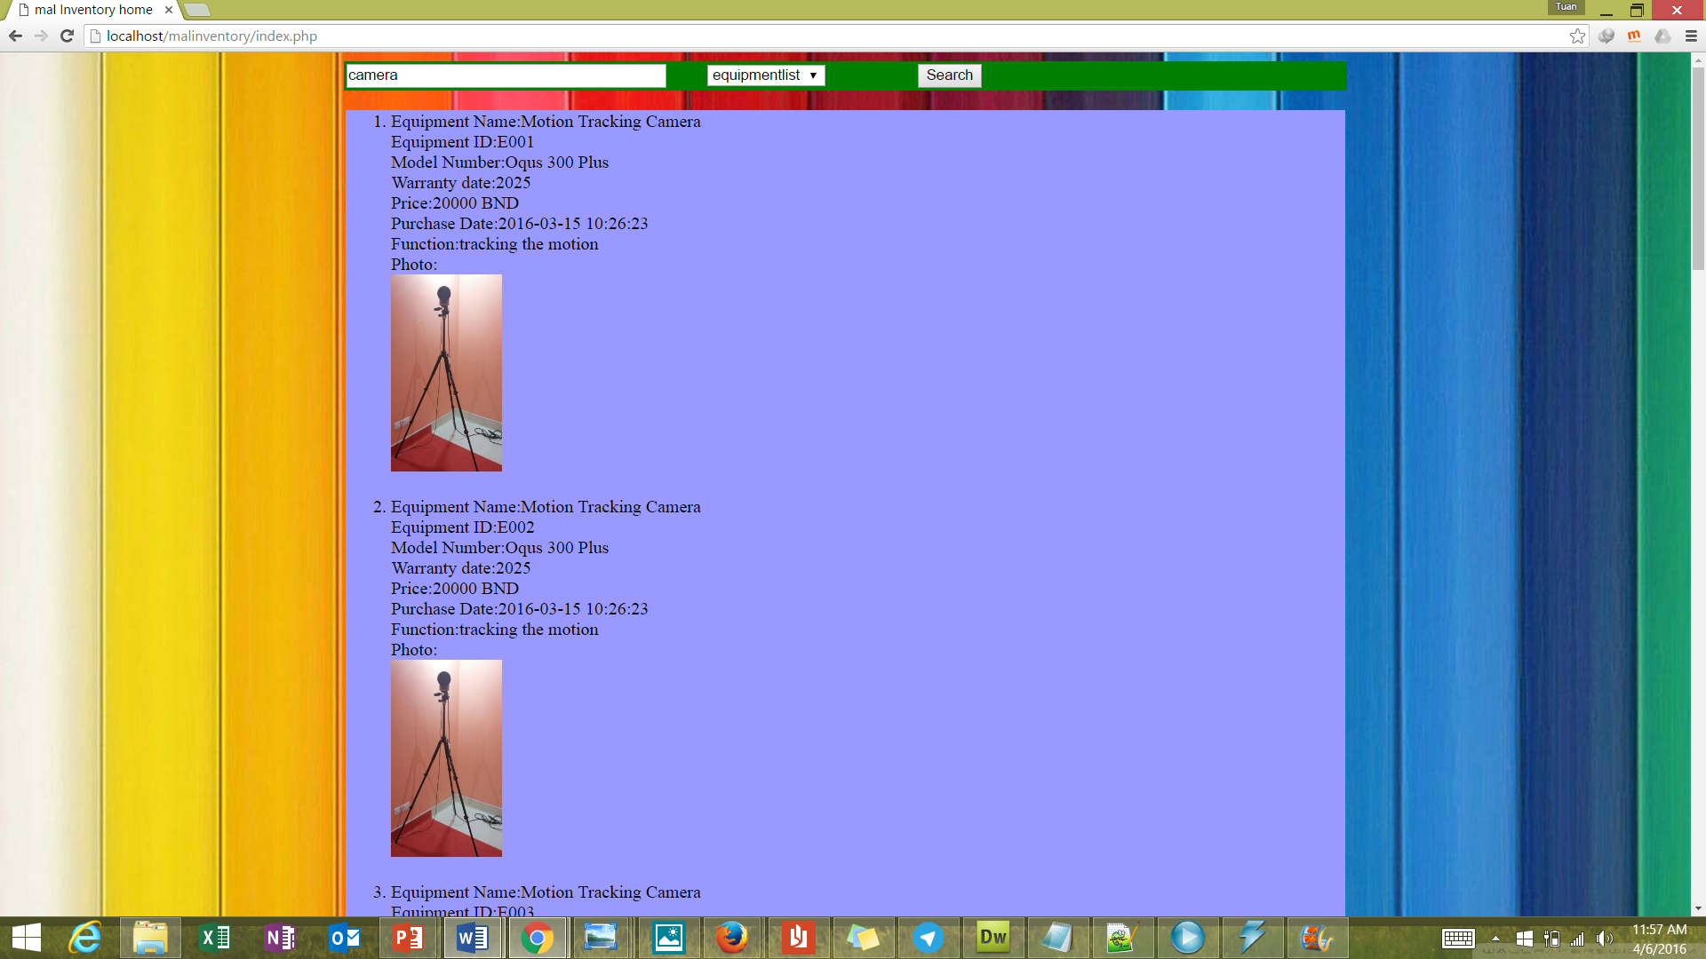
An inventory Management system for MAL (search engine)
ADMIN
View search item
View search item
USER
1 | Search engine
update
View form
Data details
database

Slide 8
Completed tasks
2) Research Group Website
Using a web development platform to develop website template that can be modified and applied by any research group at UBD
Website have generate structure with features common to all research group such as; details of current past student, research fellow , research direction, publication and filed.
The website details can be modified by administrator page that directly have connection with database.

Slide 9
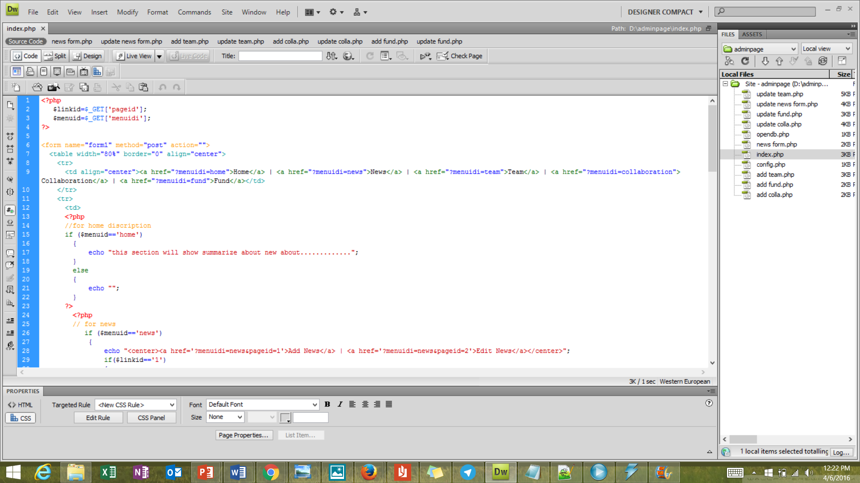
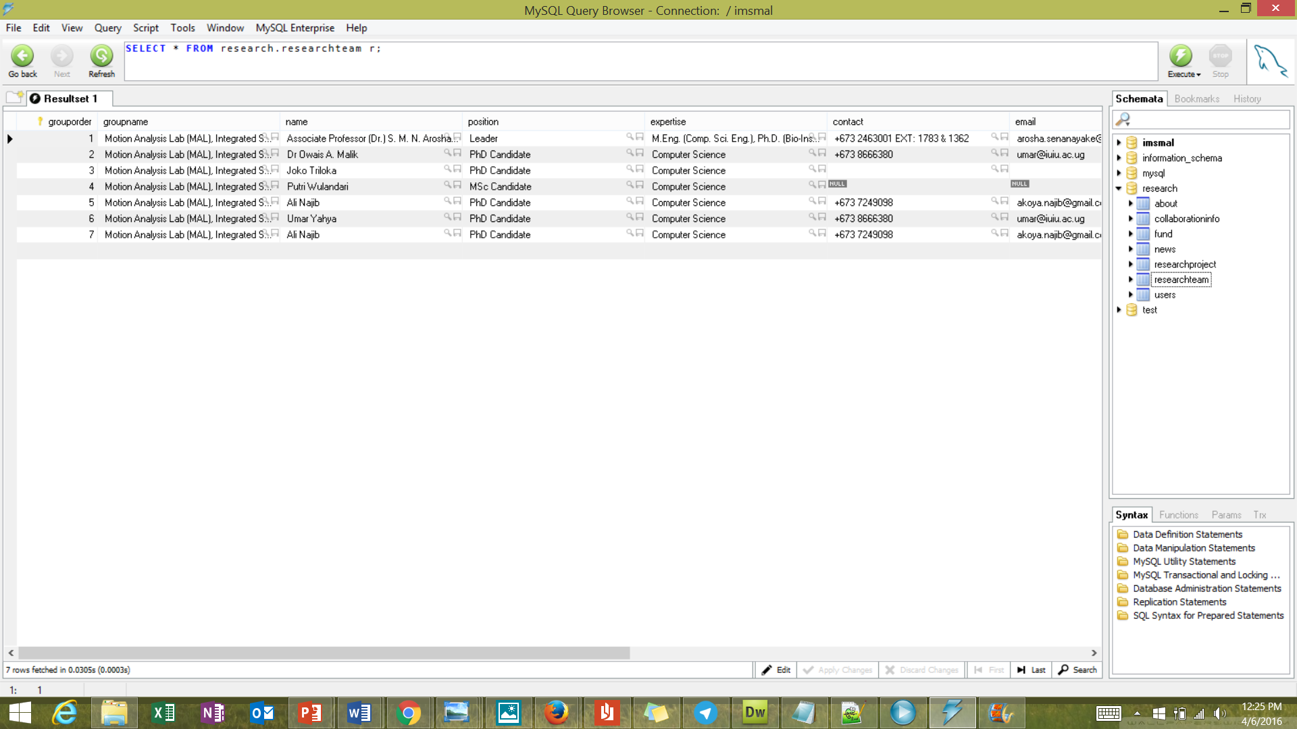
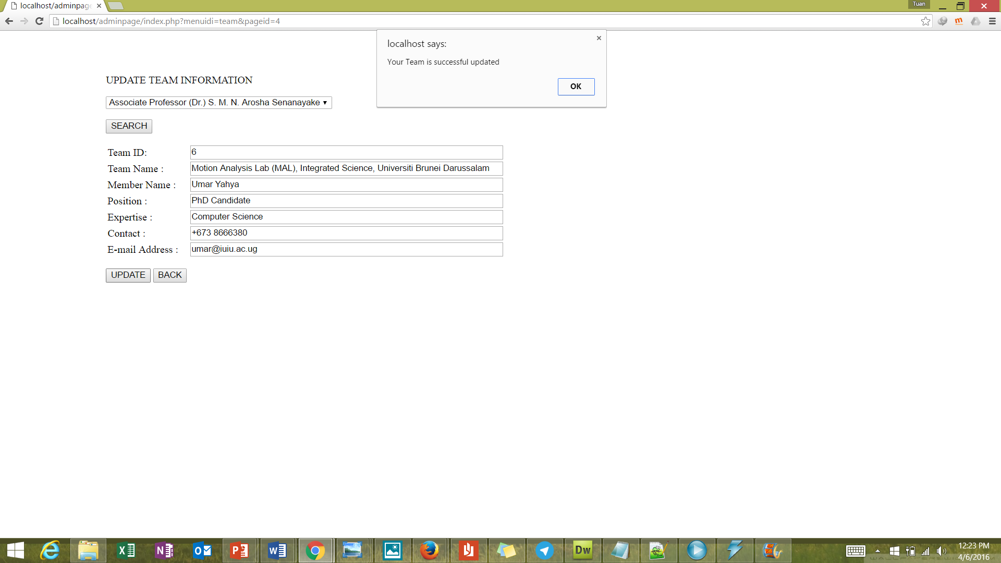
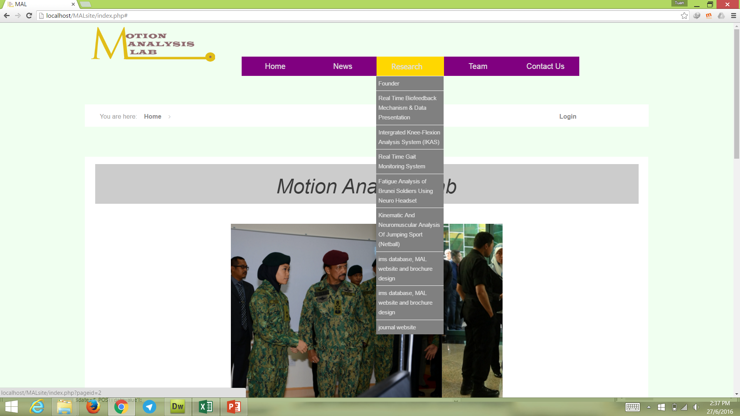
Motion Analysis Lab website
USER
search
view
1 | Website
2 | Login
3 | Admin Page
database
Add & update
view
authenticate
authenticating
ADMIN

Slide 10
Completed tasks
3) Design of a trifold brochure with research prospects of Motion Analysis Lab
Design tri-fold brochure describing the research activity of MAL including the research outcome so far. The brochure shall cover all the research projects in MAL with an objective of clear conveying MAL’s research directions to the target audience.
Using adobe Photoshop software to design the brochure

Slide 11
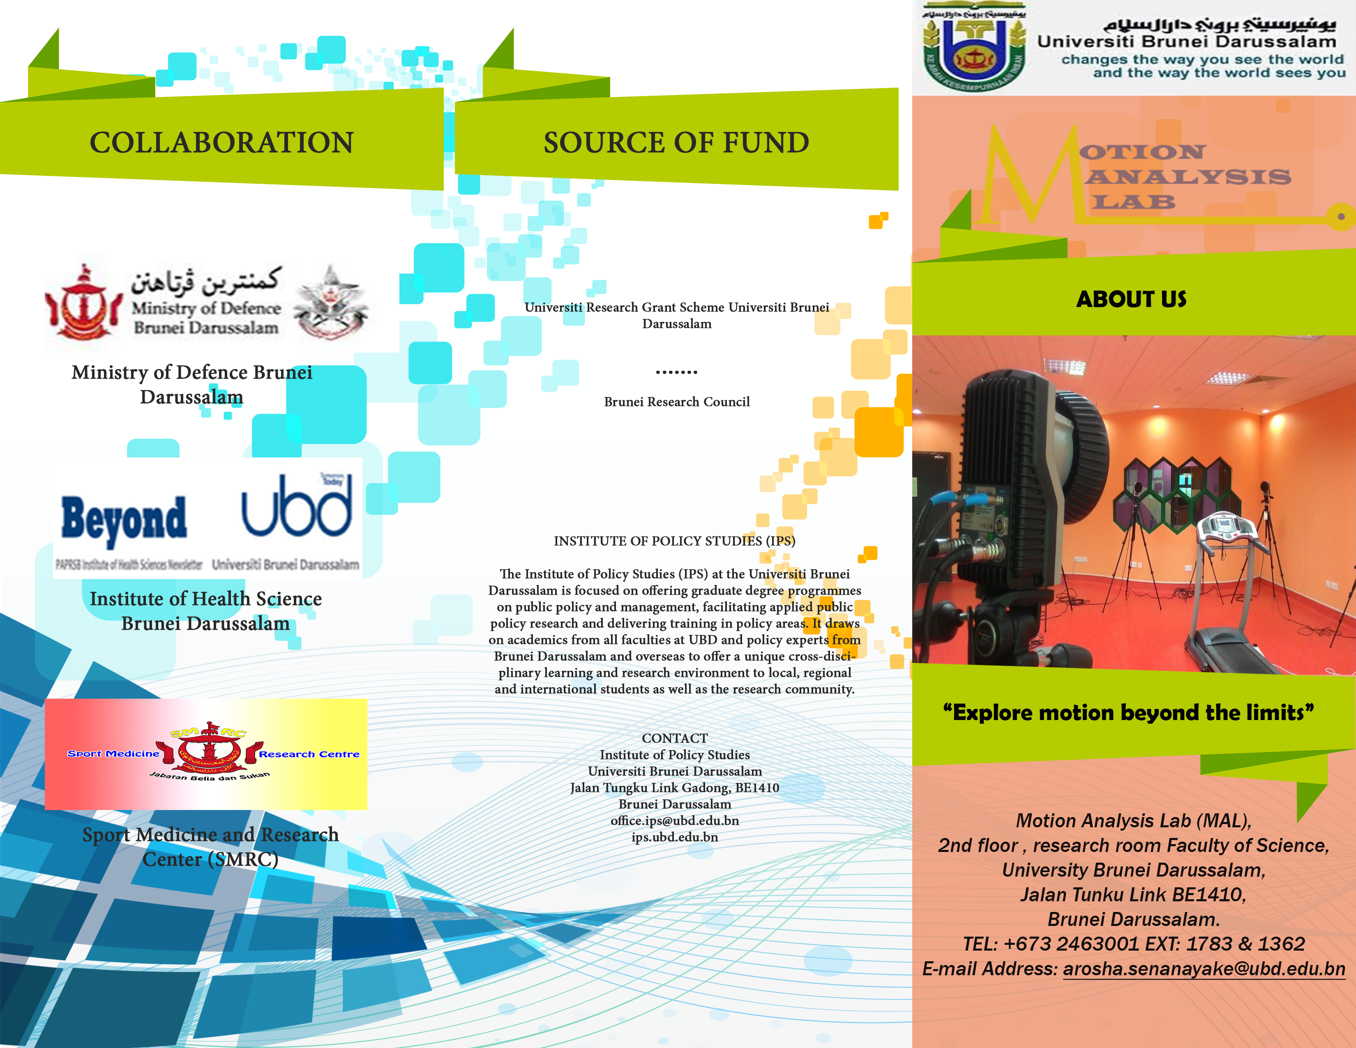

Slide 12
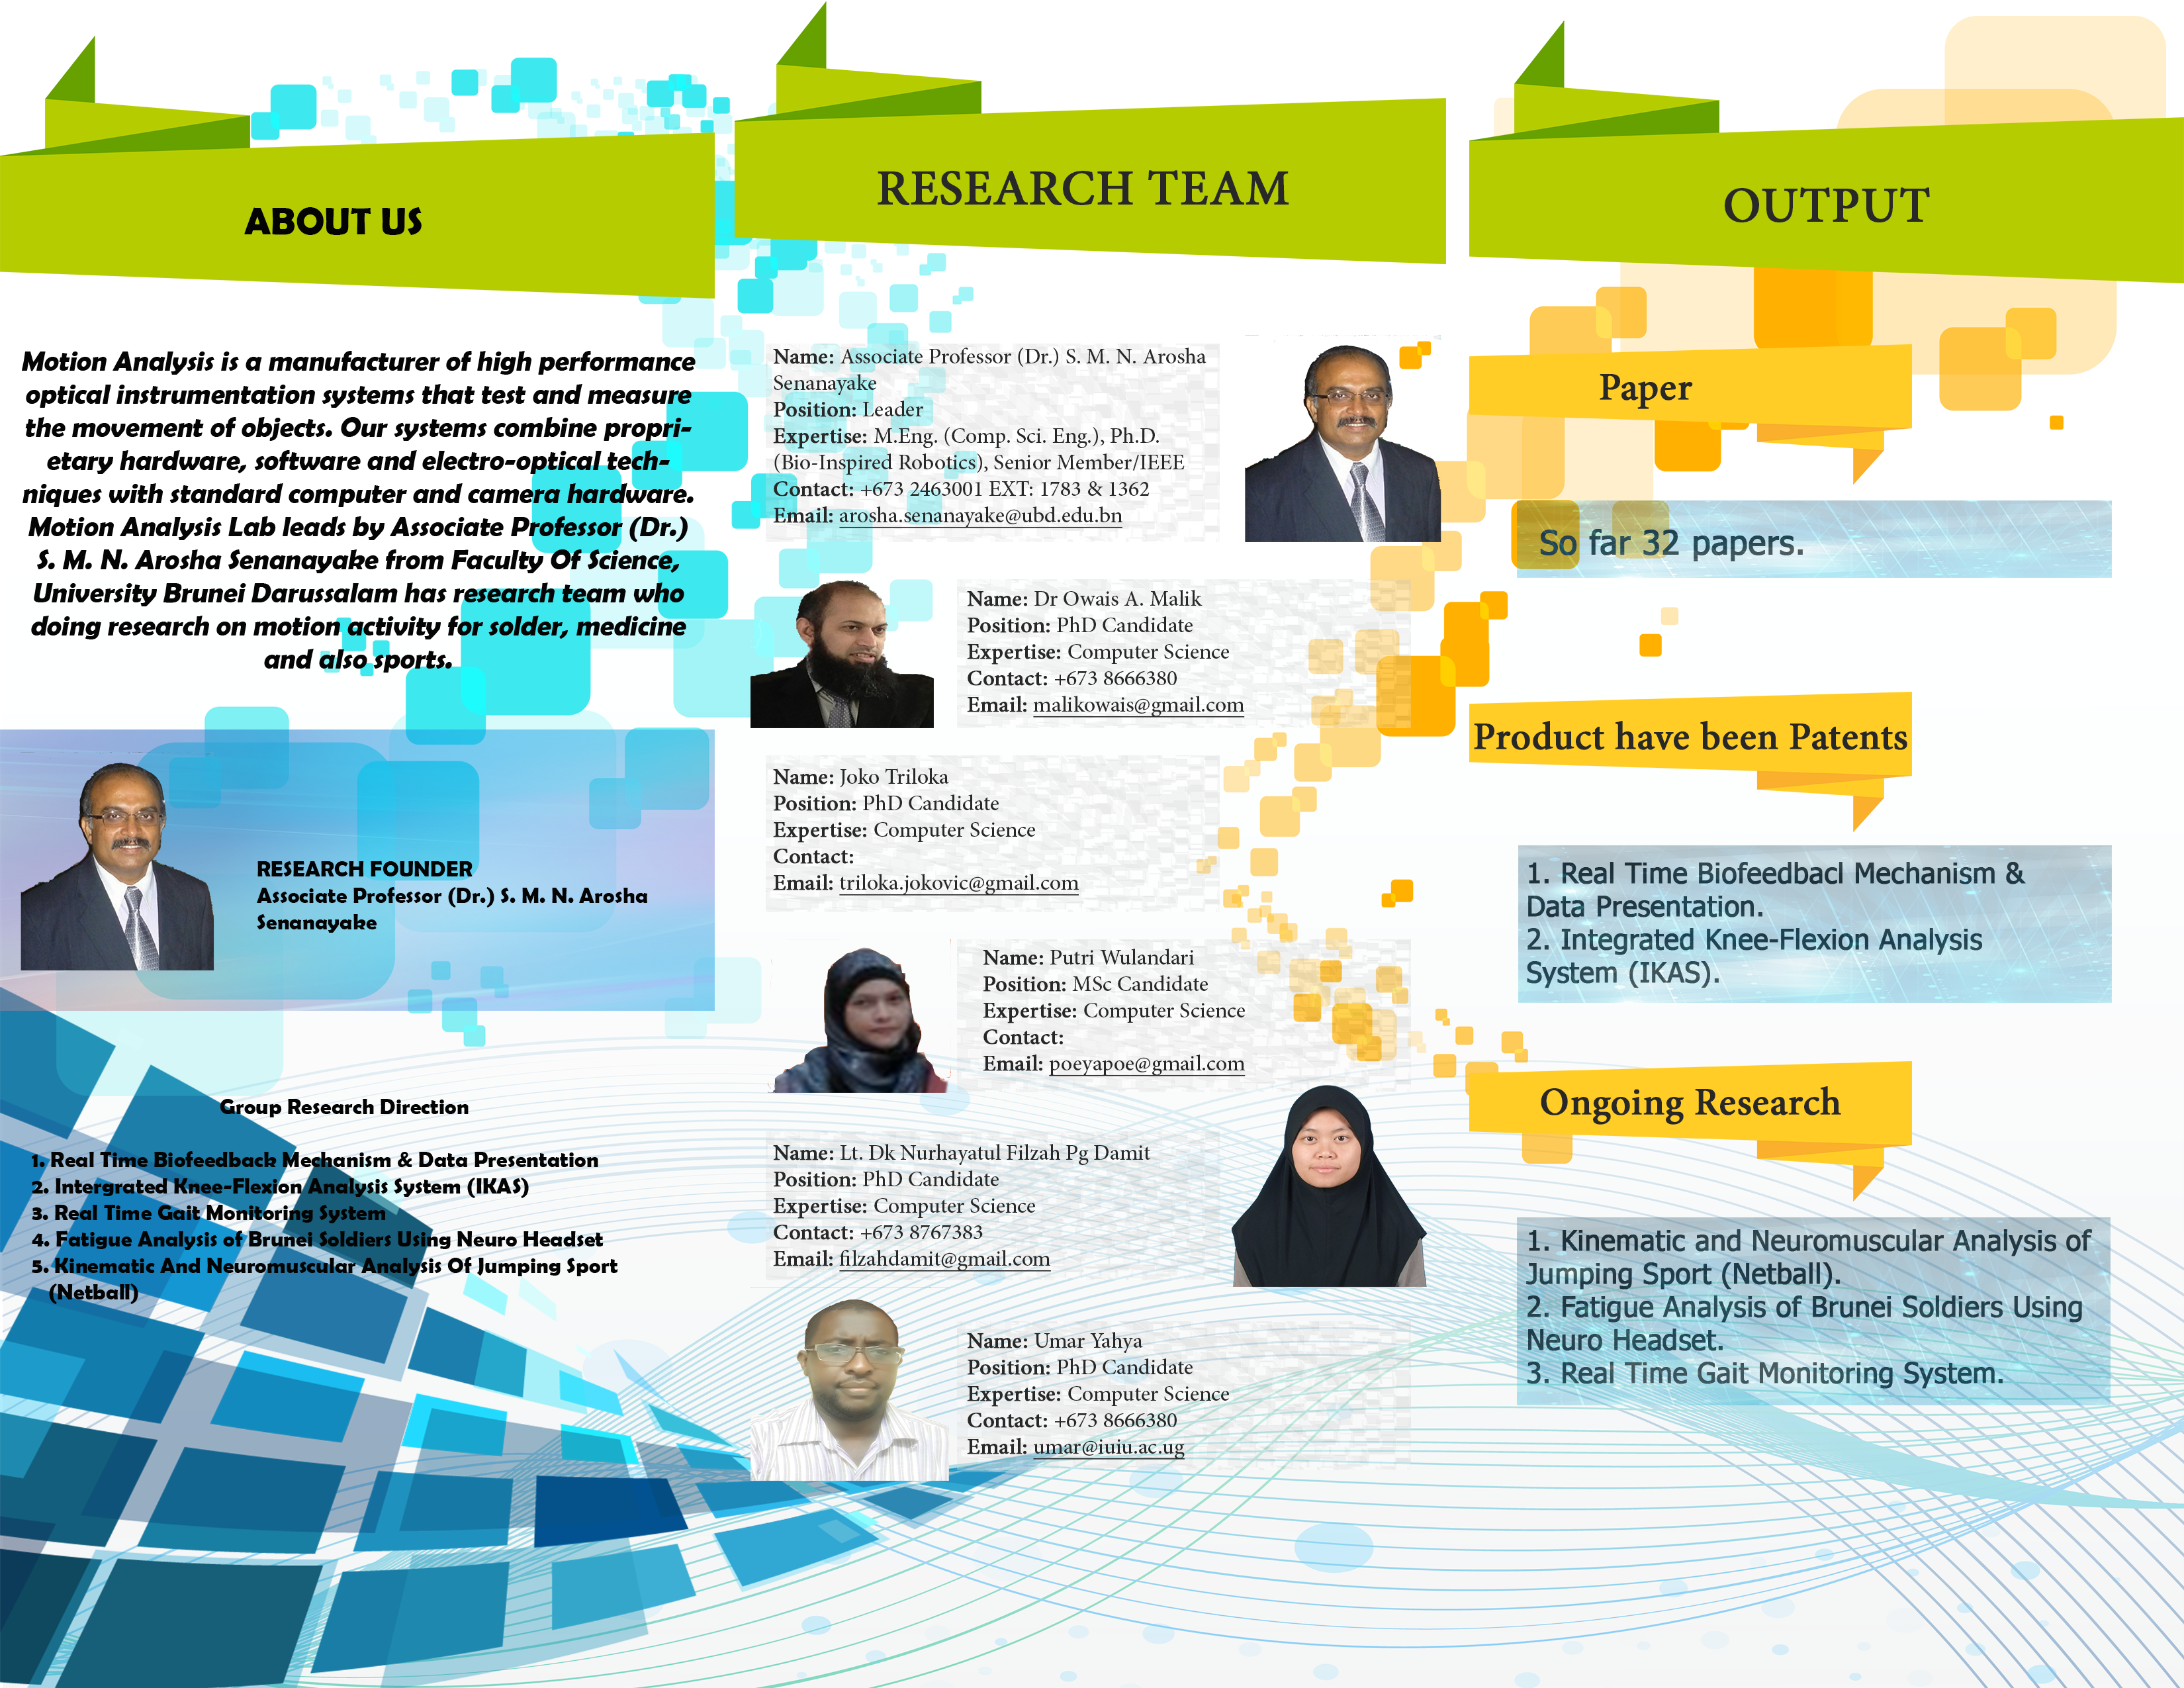

Slide 13
Remaining work
2) Report Writing
Write a details report on given placement activity.
The report describe the achievement of the specific activity for each of the task 1 until task 3
Report any challenge encountered during the task.

